Slide 1

Mudra Classification
Department of CSE
Jyothi Engineering College
Thrissur
April 15, 2021

Slide 2
Group Number : 15
Project Title : Mudra Classification
https://github.com/saurav-alt/Group15
Group Guide : Ms. Ninu Francis
Asst. Professor
Department of CSE
Group Members : Saurav Mundanatt Satheesh Kumar JEC17CS091
Sandra David JEC17CS084
Sruthi Elsa Shaji JEC17CS100
Muhammed Afthab V U JEC17CS070
15/04/21
CSE Department, JECC

Slide 3
Vision of the Department
Creating eminent and ethical leaders in the domain of Computational Sciences through quality professional education with a focus on holistic learning and excellence.
Mission of the Department
To create technically competent and ethically conscious graduates in the field of Computer Science and Engineering by encouraging holistic learning and excellence.
To prepare students for careers in Industry, Academia and the Government.
To instill Entrepreneurial Orientation and research motivation among the students of the department.
To emerge as a leader in education in the region by encouraging teaching, learning, industry and societal connect.
15/04/21

Slide 4
Introduction
The work inquires into the possibility of identifying hasta mudras in various classical dance forms of India
The review presents the details of 50% implementation of the work
15/04/21
CSE Department, JECC

Slide 5
Abstract
Every classical dance form portrays a core idea, story, etc.
Not everyone are expertise in understanding that idea, nor do everyone knows what each pose portrays
The work attempts to find the feasibility of identifying the hasta mudra depicted in a classical dance form and define its meaning
The images are to be extracted from the video input
The hand data is to be preprocessed and features are to be extracted
The classification is by the Faster R-CNN
15/04/21
CSE Department, JECC

Slide 6
Objectives
To classify the hasta mudras of a classical dance performance from a video
To convey the exact meaning of a classical dance to the viewer
15/04/21
CSE Department, JECC

Slide 7
Literature Survey
On the classification of Kathakali hand gestures using support vector machines
and convolutional neural networks
Two-level classification scheme for single-hand gestures of Sattriya dance
Heterogeneous hand gesture recognition using 3D dynamic skeletal data
Artificial neural network based identification and classification of images of
Bharatanatya gestures
Bharatanatyam hand gesture recognition using polygon representation
15/04/21
CSE Department, JECC

Slide 8
SRS
Functionalities
User interface
This is the user interface module where the user can input the video
The various mudras are identified and gives out a brief description to the
user as output
Data Pre-processing and Feature Extraction
The video data of hand mudras of various classical dances are collected
Then image segmentation and feature extraction are done followed by
training of dataset by Faster R-CNN algorithm and get output as text
messages
15/04/21
CSE Department, JECC

Slide 9
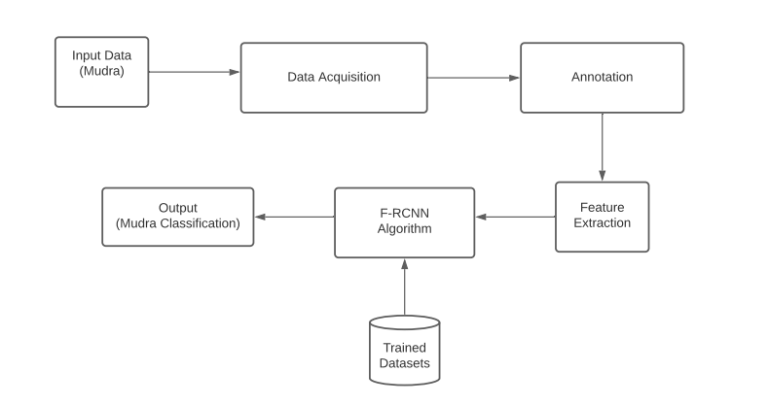
Architectural Diagram
15/04/21
CSE Department, JECC

Slide 10
Implementation
The modules 1 and 2 are implemented
Module 1 Data Acquisition Module:
The dataset was collected
80% of the dataset is to be used as training data and 20% is to be used as
test data
Module 2 Data Pre-processing Module:
The images were annotated
The LabelImg tool was used for labelling of data images
15/04/21
CSE Department, JECC

Slide 11
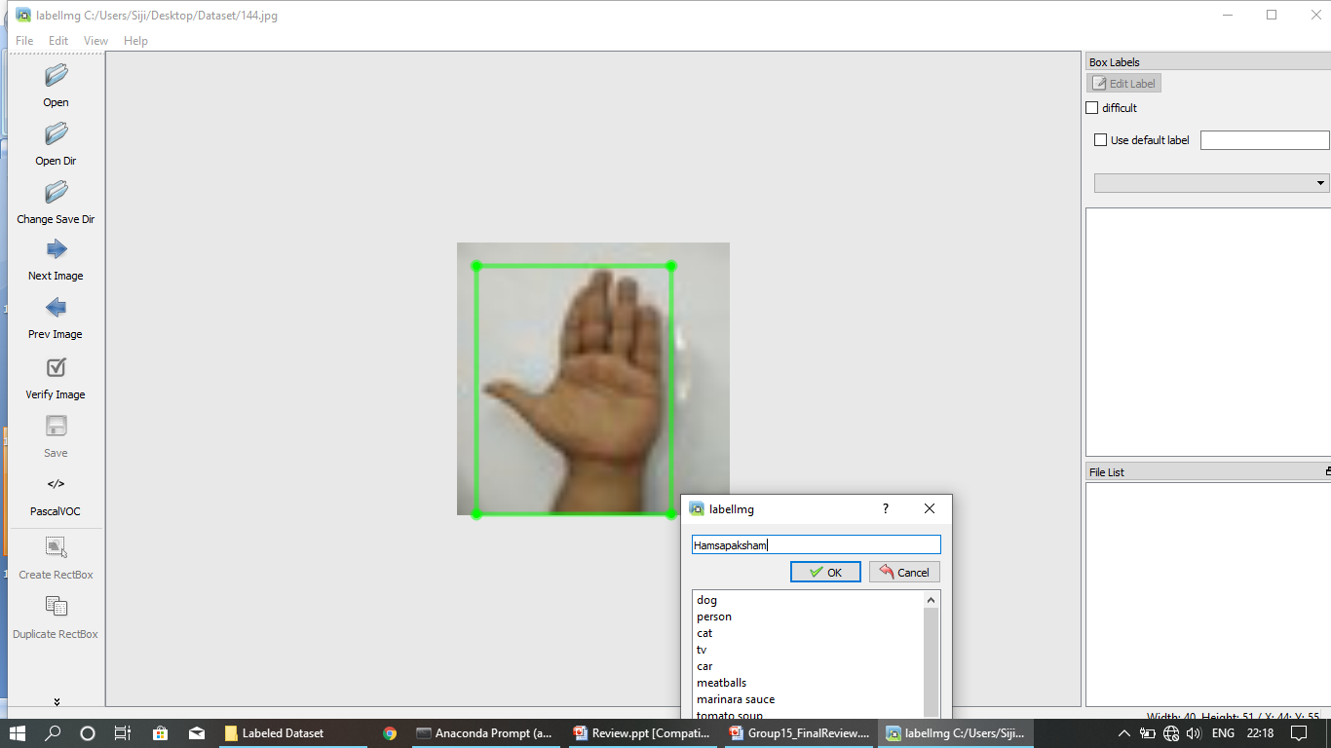
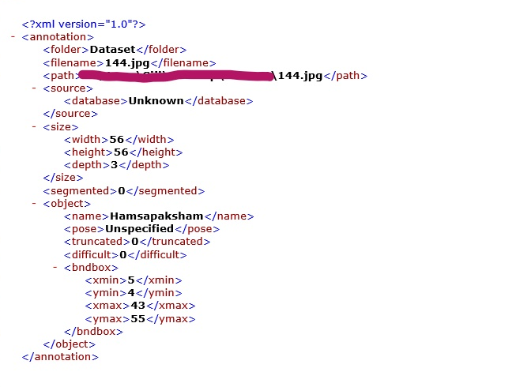
15/04/21
CSE Department, JECC

Slide 12
Module 3 Classification Module:
The module identifies and classifies the given data
Faster R-CNN is used for classification
Faster R-CNN makes testing section faster and accuracy greater than other
methods
Inception acts as the backbone of network
15/04/21
CSE Department, JECC

Slide 13
Pending Works
The module 3 is to be implemented
The Faster r-cnn is to be implemented to the data
The model is to be trained using the training data
The model is to be tested for accuracy
The work is expected to be completed by the first week of May 2021
15/04/21
CSE Department, JECC

Slide 14
Conclusions
The classical dance forms play a vital role in enriching the heritage of India
An attempt is made to explore the possibility of identifying the mudras in the classical dance video
The work makes an effort to help the viewer identify the exact mudra depicted in a dance form and gives a brief description of it
The viewer who aspires to enjoy the classical dance form to its fullest is benefited
The Indian classical dance forms get proper recognition when more people get to appreciate the art forms
15/04/21
CSE Department, JECC

Slide 15
Reference
[1] Kumar K.V.V., Kishore P.V.V. (2018) Indian Classical Dance Mudra Classification Using
HOG Features and SVM Classifier. In: Satapathy S., Bhateja V., Das S. (eds) Smart Computing
and Informatics. Smart Innovation, Systems and Technologies, vol 77. Springer, Singapore
[2] https://youtu.be/fjynQ9P2C08
[3] https://pypi.org/project/labelImg
15/04/21
CSE Department, JECC

Slide 16
Thank You
CSE Department, JECC
15/04/21

